Slide 1
Implementing a Border Gateway Protocol Solution for ISP Connectivity
CCNP ROUTE: Implementing IP Routing
Notes:
Cisco Networking Academy Program
CCNP ROUTE: Implementing IP Routing
Chapter 6: Implementing a Border Gateway Protocol Solution for ISP Connectivity

Slide 2

BGP Terminology, Concepts, and Operation

Slide 3
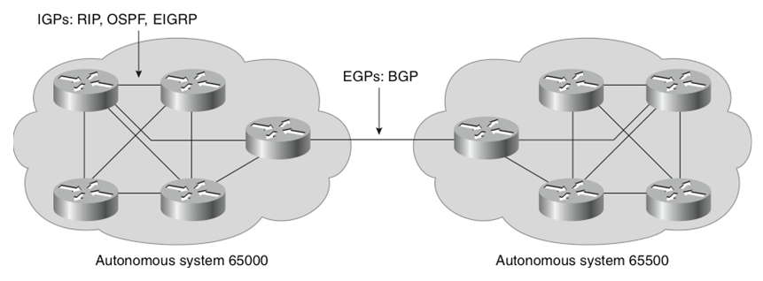
IGP versus EGP
Interior gateway protocol (IGP)
A routing protocol operating within an Autonomous System (AS).
RIP, OSPF, and EIGRP are IGPs.
Exterior gateway protocol (EGP)
A routing protocol operating between different AS.
BGP is an interdomain routing protocol (IDRP) and is an EGP.

Slide 4
Autonomous Systems (AS)
An AS is a group of routers that share similar routing policies and operate within a single administrative domain.
An AS typically belongs to one organization.
A single or multiple interior gateway protocols (IGP) may be used within the AS.
In either case, the outside world views the entire AS as a single entity.
If an AS connects to the public Internet using an exterior gateway protocol such as BGP, then it must be assigned a unique AS number which is managed by the Internet Assigned Numbers Authority (IANA).

Slide 5

IANA
The IANA is responsible for allocating AS numbers through five Regional Internet Registries (RIRs).
RIRs are nonprofit corporations established for the purpose of administration and registration of IP address space and AS numbers in key geographic locations.

Slide 6
Regional Internet Registries (RIRs)
RIR Name | Geographic Coverage | Link
AfriNIC | Continent of Africa | www.afrinic.net
APNIC (Asia Pacific Network Information Centre) | Asia Pacific region | www.apnic.net
ARIN (American Registry for Internet Numbers) | Canada, the United States, and several islands in the Caribbean Sea and North Atlantic Ocean | www.arin.net
LACNIC (Latin America and Caribbean Internet Addresses Registry) | Central and South America and portions of the Caribbean | www.lacnic.net
RIPE (Réseaux IP Européens) | Europe, the Middle East, and Central Asia | www.ripe.net

Slide 7
AS Numbers
AS numbers can be between 1 to 65,535.
RIRs manage the AS numbers between 1 and 64,512.
The 64,512 - 65,535 numbers are reserved for private use (similar to IP Private addresses).
The IANA is enforcing a policy whereby organizations that connect to a single provider use an AS number from the private pool.
Note:
The current AS pool of addresses is predicted to run out by 2012.
For this reason, the IETF has released RFC 4893 and RFC 5398.
These RFCs describe BGP extensions to increase the AS number from the two-octet (16-bit) field to a four-octet (32-bits) field, increasing the pool size from 65,536 to 4,294,967,296 values.
Notes:
You need to use the IANA-assigned autonomous system number, rather than a private autonomous system number, only if your organization plans to use an EGP, such as BGP, to connect to a public network such as the Internet.

Slide 8
BGP Basics
The Internet is a collection of autonomous systems that are interconnected to allow communication among them.
BGP provides the routing between these autonomous systems.
BGP is a path vector protocol.
It is the only routing protocol to use TCP.
OSPF and EIGRP operate directly over IP. IS-IS is at the network layer.
RIP uses the User Datagram Protocol (UDP) for its transport layer.

Slide 9
BGP Basics
BGP version 4 (BGP-4) is the latest version of BGP.
Defined in RFC 4271.
Supports supernetting, CIDR and VLSM .
BGP4 and CIDR prevent the Internet routing table from becoming too large.
Without CIDR, the Internet would have 2,000,000 + entries.
With CIDR, Internet core routers manage around 300,000 entries.
http://bgp.potaroo.net/

Slide 10
Peers = Neighbors
A “BGP peer,” also known as a “BGP neighbor,” is a specific term that is used for BGP speakers that have established a neighbor relationship.
Any two routers that have formed a TCP connection to exchange BGP routing information are called BGP peers or BGP neighbors.
Notes:
No one router can handle communications with all the routers that run BGP. There are tens of thousands of routers that run BGP and are connected to the Internet, representing more than 21,000 autonomous systems.
A BGP router forms a direct neighbor relationship with a limited number of other BGP routers. Through these BGP neighbors, a BGP router learns of the paths through the Internet to reach any advertised network. Any router that runs BGP is known as a BGP speaker.
The term “BGP peer” has a specific meaning: a BGP speaker that is configured to form a neighbor relationship with another BGP speaker for the purpose of directly exchanging BGP routing information with each other. A BGP speaker has a limited number of BGP neighbors with which it peers and forms a TCP-based relationship.
BGP peers are also known as BGP neighbors and can be either internal or external to the autonomous system.
A BGP peer must be configured with a BGP neighbor command. The administrator instructs the BGP speaker to establish a relationship with the address listed in the neighbor command and to exchange the BGP routing updates with that neighbor.

Slide 11
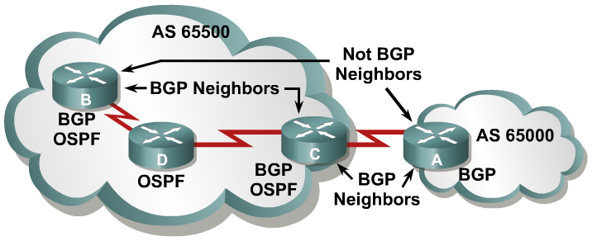
BGP Operational Overview
When two routers establish a TCP enabled BGP connection, they are called neighbors or peers.
Peer routers exchange multiple connection messages.
Each router running BGP is called a BGP speaker.

Slide 12
BGP Operational Overview
When BGP neighbors first establish a connection, they exchange all candidate BGP routes.
After this initial exchange, incremental updates are sent as network information changes.
Notes:
Incremental updates are more efficient than complete table updates.
This is especially true with BGP routers, which may contain the complete Internet routing table.

Slide 13
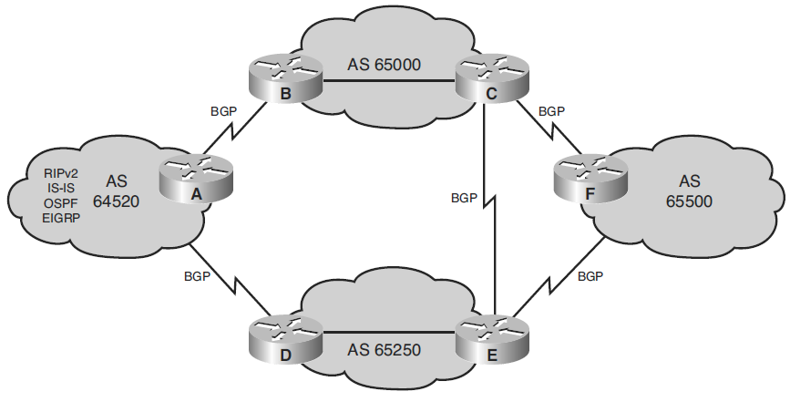
BGP Use Between AS
BGP provides an interdomain routing system that guarantees the loop-free exchange of routing information between autonomous systems.

Slide 14
Comparison BGP with IGPs
BGP works differently than IGPs because it does not make routing decisions based on best path metrics.
Instead, BGP is a policy-based routing protocol that allows an AS to control traffic flow using multiple BGP attributes.
Routers running BGP exchange network attributes including a list of the full path of BGP AS numbers that a router should take to reach a destination network.
BGP allows an organization to fully use all of its bandwidth by manipulating these path attributes.

Slide 15
Comparing IGPs with BGP
Protocol | Interior or Exterior | Type | Hierarchy Required? | Metric
RIP | Interior | Distance vector | No | Hop count
OSPF | Interior | Link state | Yes | Cost
IS-IS | Interior | Link state | Yes | Metric
EIGRP | Interior | Advanced distance vector | No | Composite
BGP | Exterior | Path vector | No | Path vectors (attributes)

Slide 16
Connecting Enterprise Networks to an ISP
Modern corporate IP networks connect to the global Internet.
Requirements that must be determined for connecting an enterprise to an ISP include the following:
Public IP address space
Enterprise-to-ISP connection link type and bandwidth
Connection redundancy
Routing protocol
Notes:
Public IP address space—In the rare case that only one-way connectivity, from the clients to the Internet, is required, private IP addresses with Network Address Translation (NAT) are used, allowing clients on a private network to communicate with servers on the public Internet.
Typically, though, two-way connectivity is needed, such that clients external to the enterprise network can access resources in the enterprise network.
In this case, both public and private address space is needed, as is routing.
Enterprise-to-ISP connection link type and bandwidth—The type and bandwidth available depends on the ISP and may include leased line, Ethernet over fiber or copper, and various types of digital subscriber line (DSL) (also known as xDSL).
The bandwidth provisioned should address the enterprise Internet connectivity requirements.
Routing protocol—Either static or dynamic routing.
Connection redundancy—The type of redundancy required for the enterprise network to ISP connectivity must be evaluated. Options include edge router redundancy, link redundancy, and ISP redundancy.

Slide 17
Public IP Address Space
Public IP addresses are used:
By internal enterprise clients to access the Internet using NAT.
To make enterprise servers accessible from the Internet using static NAT.
Public IP addresses are available from ISPs and RIRs.
Most enterprises acquire their IP addresses and AS number from ISPs.
Large enterprises may want to acquire IP addresses and AS number from a RIR.

Slide 18
Connection and Routing Questions
Which connection options does the ISP offer?
Which routing options does the ISP offer?
Will the enterprise network be connected to multiple ISPs?
Does the routing need to support one link to an ISP or multiple links, to one or multiple ISPs?
Is traffic load balancing over multiple links required?
How much routing information needs to be exchanged with the ISP?
Does the routing need to respond to the changes in the network topology, such as when a link goes down?

Slide 19
Using Static Routes Example
Static routes are the simplest way to implement routing with an ISP.
Typically a customer has a single connection to an ISP and the customer uses a default route toward the ISP while the ISP deploys static routes toward the customer.
R1(config)# router eigrp 110
R1(config-router)# network 10.0.0.0
R1(config-router)# exit
R1(config)# ip default-network 0.0.0.0
R1(config)# ip route 0.0.0.0 0.0.0.0 serial 0/0/0
Company A
ISP
10.0.0.0
172.16.0.0
172.17.0.0
Internet
R1
S0/0/0
S0/0/1
PE
PE(config)# ip route 10.0.0.0 255.0.0.0 serial 0/0/1
PE(config)# ip route 172.16.0.0 255.255.0.0 serial 0/0/1
PE(config)# ip route 172.17.0.0 255.255.0.0 serial 0/0/1

Slide 20
Using BGP
BGP can be used to dynamically exchange routing information.
BGP can also be configured to react to topology changes beyond a customer-to-ISP link.
Company A
AS 65010
ISP
AS 65020
Internet
R1
S0/0/0
S0/0/1
PE

Slide 21
Connection Redundancy
Redundancy can be achieved by deploying redundant links, deploying redundant devices, and using redundant components within a router.
The ISP connection can also be made redundant.
When a customer is connected to a single ISP the connection is referred to as single-homed or dual-homed.
When a customer is connected to multiple ISPs the connection is referred to as multihomed or dual-multihomed.
Notes:
With a connection to a single ISP when no link redundancy is used, the customer is single homed. If the ISP network fails, connectivity to the Internet is interrupted.
With a connection to a single ISP, redundancy can be achieved if two links toward the same ISP are used effectively. This is called being dual homed.
With connections to multiple ISPs, redundancy is built into the design. A customer connected to multiple ISPs is said to be multihomed, and is thus resistant to a single ISP failure.
To enhance the resiliency further with connections to multiple ISPs, a customer can have two links toward each ISP. This solution is called being dual multihomed.

Slide 22


Connection Redundancy
Connecting to One ISP
Connecting to Two or more ISPs
Single-homed
Multihomed
Dual-homed
Dual-multihomed

Slide 23
Connecting to One ISP: Single-Homed
The connection type depends on the ISP offering (e.g., leased line, xDSL, Ethernet) and link failure results in a no Internet connectivity.
The figure displays two options:
Option 1: Static routes are typically used with a static default route from the customer to the ISP, and static routes from the ISP toward customer networks.
Option 2: When BGP is used, the customer dynamically advertises its public networks and the ISP propagates a default route to the customer.
Option 1:
Default Route
Static Route(s)
Company A
AS 65010
ISP
AS 65020
Internet
R1
S0/0/0
S0/0/1
PE
Option 2:
BGP

Slide 24
Connecting to One ISP: Dual-Homed
The figure displays two dual-homed options:
Option 1: Both links can be connected to one customer router.
Option 2: To enhance resiliency, the two links can terminate at separate routers in the customer’s network.
Option 1:
Company A
ISP
Internet
R1
PE
Option 2:
Company A
ISP
Internet
R1
PE
R2

Slide 25
Connecting to One ISP: Dual-Homed
Routing deployment options include:
Primary and backup link functionality in case the primary link fails.
Load sharing using Cisco Express Forwarding (CEF).
Regardless, routing can be either static or dynamic (BGP).
Option 1:
Company A
ISP
Internet
R1
PE
Option 2:
Company A
ISP
Internet
R1
PE
R2
Notes:
Depending on the Service-level agreement (SLA) signed with the ISP.

Slide 26
Connecting to Multiple ISPs: Multihomed
Connections from different ISPs can terminate on the same router, or on different routers to further enhance the resiliency.
Routing must be capable of reacting to dynamic changes therefore BGP is typically used.
ISP 1
PE
Company A
R1
Internet
R2
ISP 2
PE
Notes:
Depending on the Service-level agreement (SLA) signed with the ISP.

Slide 27
Connecting to Multiple ISPs: Multihomed
Multihomed benefits include:
Achieving an ISP-independent solution.
Scalability of the solution, beyond two ISPs.
Resistance to a failure to a single ISP.
Load sharing for different destination networks between ISPs.
ISP 1
PE
Company A
R1
Internet
R2
ISP 2
PE
Notes:
Depending on the Service-level agreement (SLA) signed with the ISP.

Slide 28
Connecting Multiple ISPs: Dual-Multihomed
Dual multihomed includes all the benefits of multihomed connectivity, with enhanced resiliency.
The configuration typically has multiple edge routers, one per ISP, and uses BGP.
ISP 1
PE
Company A
R1
Internet
R2
ISP 2
PE
Notes:
Depending on the Service-level agreement (SLA) signed with the ISP.

Slide 29
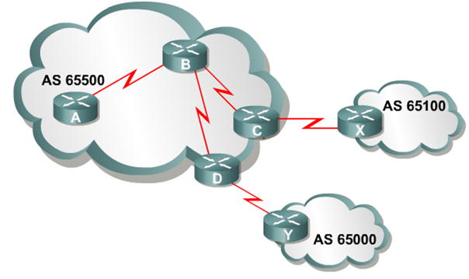
Using BGP in an Enterprise Network
When BGP is running between routers in different AS, it is called External BGP (EBGP).
When BGP is running between routers in the same AS, it is called Internal BGP (IBGP).
IBGP
IBGP
IBGP
EBGP
EBGP

Slide 30
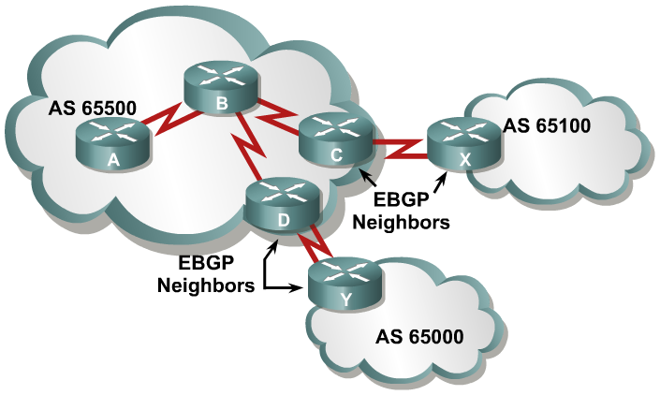
External BGP
EBGP neighbors are in different autonomous systems.
EBGP neighbors need to be directly connected.
Notes:
Recall that when BGP is running between routers in different autonomous systems, it is called EBGP. By default, routers running EBGP are directly connected to each other.
An EBGP neighbor is a router outside this autonomous system; an IGP is not run between the EBGP neighbors. For two routers to exchange BGP routing updates, the TCP-reliable transport layer on each side must successfully pass the TCP three-way handshake before the BGP session can be established. Therefore, the IP address used in the BGP neighbor command must be reachable without using an IGP, which can be accomplished by pointing at an address that is reachable through a directly connected network or by using static routes to that IP address. Generally, the neighbor address that is used is the address on a directly connected network.

Slide 31
EBGP Neighbor Relationship Requirements
Define neighbors:
A TCP session (three-way handshake) must be established before starting BGP routing update exchanges.
Reachability:
EBGP neighbors are usually directly connected.
Different AS number:
EBGP neighbors must have different AS numbers.

Slide 32
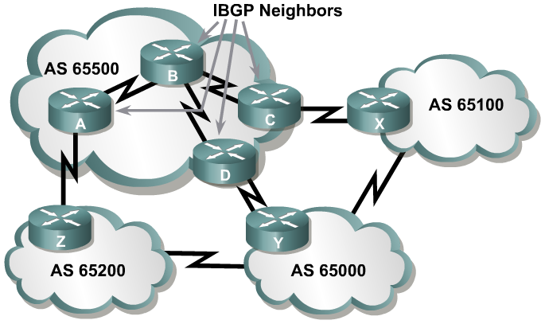
Internal BGP
IBGP neighbors are in the same autonomous systems.
IBGP neighbors do not need to be directly connected.
Notes:
Recall that BGP that runs between routers within the same autonomous system is called IBGP. IBGP runs within an autonomous system to exchange BGP information so that all BGP speakers have the same BGP routing information about outside autonomous systems.
Routers running IBGP do not have to be directly connected to each other as long as they can reach each other so that TCP handshaking can be performed to set up the BGP neighbor relationships. The IBGP neighbor can be reached by a directly connected network, static routes, or by the internal routing protocol. Because multiple paths generally exist within an autonomous system to reach the other IBGP routers, a loopback address is generally used in the BGP neighbor command to establish the IBGP sessions.
Example: Internal BGP
When multiple routers in an autonomous system are running BGP, they exchange BGP routing updates with one another. In the figure, routers A, D, and C learn the paths to the external autonomous systems from their respective EBGP neighbors (Z, Y, and X). If the link between D and Y goes down, D must learn new routes to the external autonomous systems. Other BGP routers within AS 65500 that were using D to get to external networks must also be informed that the path through D is not available. Those BGP routers within AS 65500 need to have the alternate paths through routers A and C in their BGP forwarding database. You must set up IBGP sessions between all BGP routers in AS 65500, so each router within the autonomous system learns about paths to the external networks via IBGP.

Slide 33
IBGP Neighbor Relationship Requirements
Define neighbors:
A TCP session (three-way handshake) must be established before starting BGP routing update exchanges.
Reachability:
IBGP neighbors must be reachable usually by using an IGP.
Loopback IP addresses are typically used to identify IBGP neighbors.
Same AS number:
IBGP neighbors must have the same AS number.

Slide 34
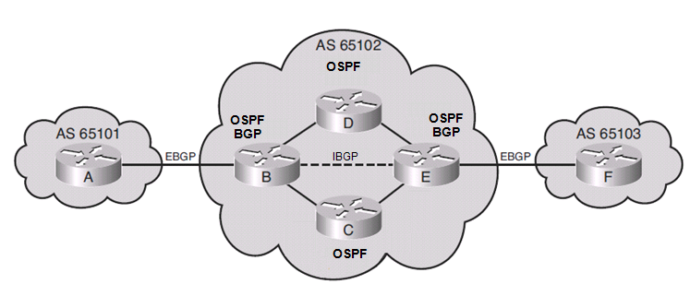
IBGP in a Transit AS
A transit AS is an AS that routes traffic from one external AS to another external AS.
In this example, AS 65102 is a service provider network.
Only the two edge routers (router B and E) are running BGP and have established an IBGP neighbor relationship using OSPF.
Although the EBGP routes could be redistributed into OSPF, the potential number of BGP routes may overwhelm OSPF and is therefore not recommended.
Notes:
Because the current Internet routing table is very large, redistributing all the BGP routes into an IGP is not a scalable way for the interior routers within an autonomous system to learn about the external networks.
Another method that you can use is to run IBGP on all routers within the autonomous system.
It is important to know that all routers in the path between IBGP neighbors within an autonomous system, known as the transit path, must also be running BGP.
These IBGP sessions must be fully meshed.

Slide 35
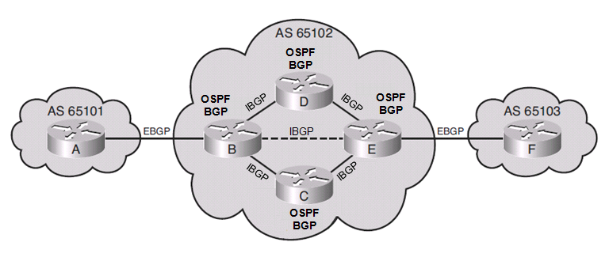
IBGP in a Transit AS
A better solution for a provider network would be to have a fully meshed BGP internetwork.
BGP runs on all internal routers and all routers establish IBGP sessions.
IBGP routers have complete knowledge of external routes.
Notes:
Because the current Internet routing table is very large, redistributing all the BGP routes into an IGP is not a scalable way for the interior routers within an autonomous system to learn about the external networks.
Another method that you can use is to run IBGP on all routers within the autonomous system.
It is important to know that all routers in the path between IBGP neighbors within an autonomous system, known as the transit path, must also be running BGP.
These IBGP sessions must be fully meshed.

Slide 36
IBGP in a Nontransit AS
A nontransit AS is an AS that does not route traffic from one external AS to another external AS.
Nontransit AS networks are typically enterprise networks.
All routers in a nontransit AS must still have complete knowledge of external routes.
To avoid routing loops within an AS, BGP specifies that routes learned through IBGP are never propagated to other IBGP peers.
It is assumed that the sending IBGP neighbor is fully meshed with all other IBGP speakers and has sent each IBGP neighbor the update.
Notes:
Because the current Internet routing table is very large, redistributing all the BGP routes into an IGP is not a scalable way for the interior routers within an autonomous system to learn about the external networks.
Another method that you can use is to run IBGP on all routers within the autonomous system.

Slide 37
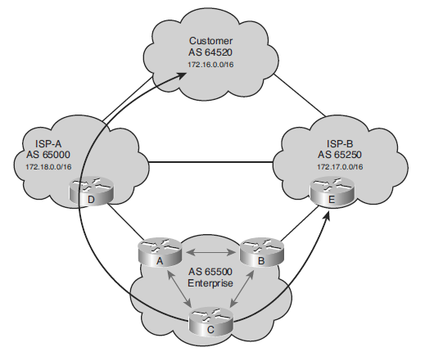
BGP in an Enterprise Example
Enterprise AS 65500 is learning routes from both ISP-A and ISP-B via EBGP and is also running IBGP on all of its routers.
If one of the connections to the ISPs goes down, traffic will be sent through the other ISP.
An undesirable situation could occur if the enterprise AS is configured as a transit AS.
For example, AS 65500 learns the 172.18.0.0/16 route from ISP-A.
If router B advertises that route to ISP-B, then ISP-B may decide to use it.
This undesirable configuration could be avoided through careful BGP configuration.
Notes:
Enterprise AS 65500 in the above figure is learning routes from both ISP-A and ISP-B via EBGP and is also running IBGP on all of its routers.
AS 65500 learns about routes and chooses the best way to each one based on the configuration of the routers in the autonomous system and the BGP routes passed from the ISPs.
If one of the connections to the ISPs goes down, traffic will be sent through the other ISP.
One of the routes that AS 65500 learns from ISP-A is the route to 172.18.0.0/16. If that route is passed through AS 65500 using IBGP and is mistakenly announced to ISP-B, then ISP-B may decide that the best way to get to 172.18.0.0/16 is through AS 65500, instead of through the Internet. AS 65500 would then be considered a transit autonomous system, which is a very undesirable situation. AS 65500 wants to have a redundant Internet connection, but does not want to act as a transit autonomous system between the two ISPs. Careful BGP configuration is required to avoid this situation.

Slide 38
Three Multihoming Connection Options
Each ISP passes only a default route to the AS.
The default route is passed on to internal routers.
Each ISP passes only a default route and provider-owned specific routes to the AS.
These routes may be propagated to internal routers, or all internal routers in the transit path can run BGP to exchange these routes.
Each ISP passes all routes to the AS.
All internal routers in the transit path run BGP to exchange these routes.

Slide 39
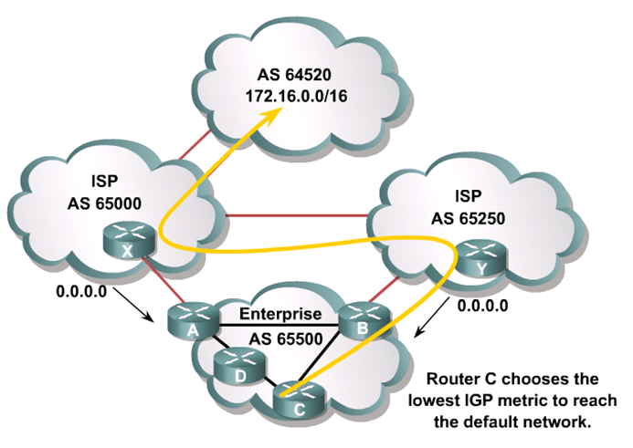
Default Routes from All Providers
Notes:
The first multihoming option is to receive only a default route from each ISP. This configuration requires the least resources within the autonomous system because a default route is used to reach any external destinations. The autonomous system sends all its routes to the ISPs, which process and pass them on to other autonomous systems.
If a router in the autonomous system learns about multiple default routes, the local interior routing protocol installs the best default route into the routing table. From the perspective of this router, it takes the default route with the least-cost IGP metric. This IGP default route will route packets destined to the external networks to an edge router of this autonomous system, which is running EBGP with the ISPs. The edge router will use the BGP default route to reach all external networks.
The route that inbound packets take to reach the autonomous system is decided outside the autonomous system (within the ISPs and other autonomous systems).
Regional ISPs that have multiple connections to national or international ISPs commonly implement this option. The regional ISPs do not use BGP for path manipulation; however, they require the capability of adding new customers as well as the networks of the customers. If the regional ISP does not use BGP, then each time that the regional ISP adds a new set of networks, the customers must wait until the national ISPs add these networks to their BGP process and place static routes pointing at the regional ISP. By running EBGP with the national or international ISPs, the regional ISP needs to add only the new networks of the customers to its BGP process. These new networks automatically propagate across the Internet with minimal delay.
A customer that chooses to receive default routes from all providers must understand the following limitations of this option:
Path manipulation cannot be performed because only a single route is being received from each ISP.
Bandwidth manipulation is extremely difficult and can be accomplished only by manipulating the IGP metric of the default route.
Diverting some of the traffic from one exit point to another is challenging because all destinations are using the same default route for path selection.
Example: Default Routes from All Providers
In the above figure, AS 65000 and AS 65250 send default routes into AS 65500. The ISP that a specific router within AS 65500 uses to reach any external address is decided by the IGP metric that is used to reach the default route within the autonomous system.
For example, if you use RIP within AS 65500, router C selects the route with the lowest hop count to the default route when sending packets to network 172.16.0.0.

Slide 40
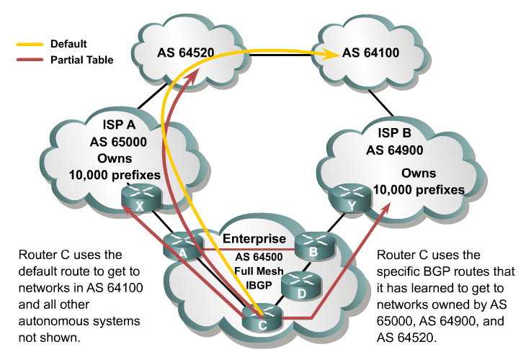
Default Routes and Partial Updates
Notes:
In the second design option for multihoming, all ISPs pass default routes plus select specific routes to the autonomous system.
An enterprise running EBGP with an ISP that wants a partial routing table generally receives the networks that the ISP and its other customers own. The enterprise can also receive the routes from any other autonomous system.
Major ISPs are assigned between 2000 and 10,000 CIDR blocks of IP addresses from the IANA, which they reassign to their customers. If the ISP passes this information to a customer that wants only a partial BGP routing table, the customer can redistribute these routes into its IGP. The internal routers of the customer (these routers are not running BGP) can then receive these routes via redistribution. They can take the nearest exit point based upon the best metric of specific networks instead of taking the nearest exit point based on the default route.
Acquiring a partial BGP table from each provider is beneficial because path selection will be more predictable than when using a default route.
Example: Default Routes from All Providers and Partial Table
In this figure, ISPs in AS 65000 and AS 64900 send default routes and the routes that each ISP owns to AS 64500. The enterprise (AS 64500) asked both providers to also send routes to networks in AS 64520 due to the amount of traffic between AS 64520 and AS 64500.
By running IBGP between the internal routers within AS 64500, AS 64500 can choose the optimal path to reach the customer networks (AS 64520 in this case). The routes to AS 64100 and to other autonomous systems not shown in the figure that are not specifically advertised to AS 64500 by ISP A and ISP B are decided by the IGP metric that is used to reach the default route within the autonomous system.

Slide 41
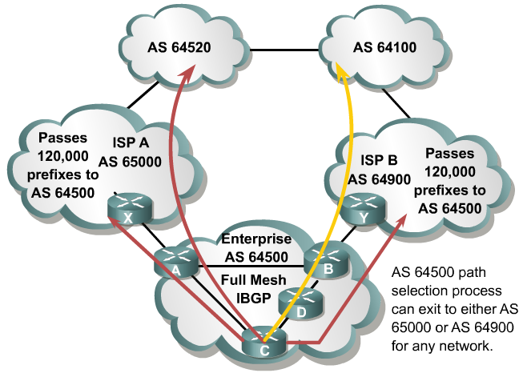
Full Routes from All Providers
Notes:
In the third multihoming option, all ISPs pass all routes to the autonomous system, and IBGP is run on at least all the routers in the transit path in this autonomous system.
This option allows the internal routers of the autonomous system to take the path through the best ISP for each route.
This configuration requires a lot of resources within the autonomous system because it must process all the external routes.
The autonomous system sends all of its routes to the ISPs, which process the routes and pass them to other autonomous systems.
The figure illustrates an example. ISP A autonomous system 65000 and ISP B autonomous system 64900 send all routes into Enterprise autonomous system 64500.
The ISP that a specific router within autonomous system 64500 uses to reach the external networks is determined by BGP. The routers in autonomous system 64500 can be configured to influence the path to certain networks. For example, Router A and Router B can influence the outbound traffic from autonomous system 64500.

Slide 42
BGP Path Vector Characteristics
Internal routing protocols announce a list of networks and the metrics to get to each network.
In contrast, BGP routers exchange network reachability information, called path vectors, made up of path attributes.

Slide 43
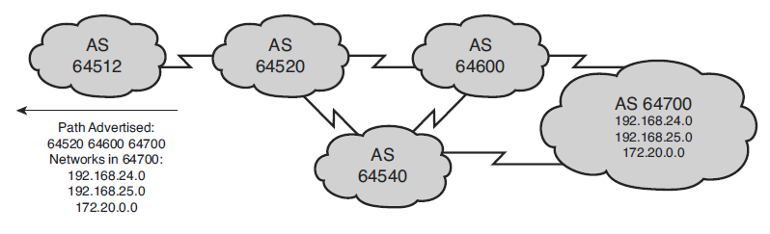
BGP Path Vector Characteristics
The path vector information includes:
A list of the full path of BGP AS numbers (hop by hop) necessary to reach a destination network.
Other attributes including the IP address to get to the next AS (the next-hop attribute) and how the networks at the end of the path were introduced into BGP (the origin code attribute).

Slide 44
When to Use BGP
Most appropriate when the effects of BGP are well-understood and at least one of the following conditions exists:
The AS has multiple connections to other autonomous systems.
The AS allows packets to transit through it to reach other autonomous systems (eg, it is a service provider).
Routing policy and route selection for traffic entering and leaving the AS must be manipulated.

Slide 45
When Not to Use BGP
Do not use BGP if one or more of the following conditions exist:
A single connection to the Internet or another AS.
Lack of memory or processor power on edge routers to handle constant BGP updates.
You have a limited understanding of route filtering and the BGP path-selection process.
In these cases, use static or default routes instead.

Slide 46
BGP Synchronization
The BGP synchronization rule states that:
“A BGP router should not use, or advertise to an external neighbor, a route learned by IBGP, unless that route is local or is learned from the IGP.”
If synchronization is enabled, a router learning a route via IBGP waits until the IGP has propagated the route within the autonomous system and then advertises it to external peers.
With the default of synchronization disabled, BGP can use and advertise to external BGP neighbors routes learned from an IBGP neighbor that are not present in the local routing table.
BGP synchronization is disabled by default in Cisco IOS Software Release 12.2(8)T and later.
It was on by default in earlier Cisco IOS Software releases.

Slide 47
BGP Table
BGP keeps its own table for storing BGP information received from and sent to BGP neighbors.
This table is also known as the BGP table, BGP topology table, BGP topology database, BGP routing table, and the BGP forwarding database.
The router offers the best routes from the BGP table to the IP routing table.

Slide 48
BGP Tables
Neighbor table
List of BGP neighbors
BGP table (forwarding database)
List of all networks learned from each neighbor
Can contain multiple paths to destination networks
Contains BGP attributes for each path
IP routing table
List of best paths to destination networks
Notes:
A router running BGP keeps its own tables to store BGP information that it receives from and sends to other routers, including a neighbor table, a BGP table (also called a forwarding database or topology database), and an IP routing table.
For BGP to establish an adjacency, you must configure it explicitly for each neighbor. BGP forms a TCP relationship with each of the configured neighbors and keeps track of the state of these relationships by periodically sending a BGP/TCP keepalive message.
The BGP sends BGP/TCP keepalives by default every 60 seconds.
After establishing an adjacency, the neighbors exchange the BGP routes that are in their IP routing table. Each router collects these routes from each neighbor that successfully establishes an adjacency and then places them in its BGP forwarding database. All routes that have been learned from each neighbor are placed into the BGP forwarding database. The best routes for each network are selected from the BGP forwarding database using the BGP route selection process and then offered to the IP routing table.
Each router compares the offered BGP routes to any other possible paths to those networks, and the best route, based on administrative distance, is installed in the IP routing table.
EBGP routes (BGP routes learned from an external autonomous system) have an administrative distance of 20. IBGP routes (BGP routes learned from within the autonomous system) have an administrative distance of 200.

Slide 49
Path Attributes
Path attributes are a set of BGP metrics describing the path to a network (route).
BGP uses the path attributes to determine the best path to the networks.
Some attributes are mandatory and automatically included in update messages while others are manually configurable.
BGP attributes can be used to enforce a routing policy.
Configuring BGP attributes provides administrators with many more path control options.
E.g., filter routing information, prefer certain paths, customize BGP’s behavior.

Slide 50
Attributes
Some attributes are mandatory and automatically included in update messages while others are manually configurable.
Attribute | EBGP | IBGP
AS_PATH | Well-known Mandatory | Well-known Mandatory
NEXT_HOP | Well-known Mandatory | Well-known Mandatory
ORIGIN | Well-known Mandatory | Well-known Mandatory
LOCAL_PREF | Not allowed | Well-known Discretionary
ATOMIC_AGGREGATE | Well-known Discretionary | Well-known Discretionary
AGGREGATOR | Optional Transitive | Optional Transitive
COMMUNITY | Optional Transitive | Optional Transitive
MULTI_EXIT_DISC | Optional Nontransitive | Optional Nontransitive
Automatically included in update message
Can be configured to help provide path control.

Slide 51
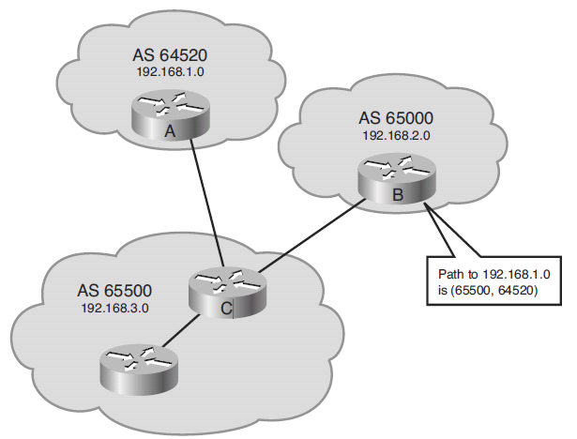
Well-Known Mandatory: AS_PATH
The AS_PATH attribute contains a list of AS numbers to reach a route.
Whenever a route update passes through an AS, the AS number is added to the beginning of the AS_PATH attribute before it is advertised to the next EBGP neighbor.

Slide 52
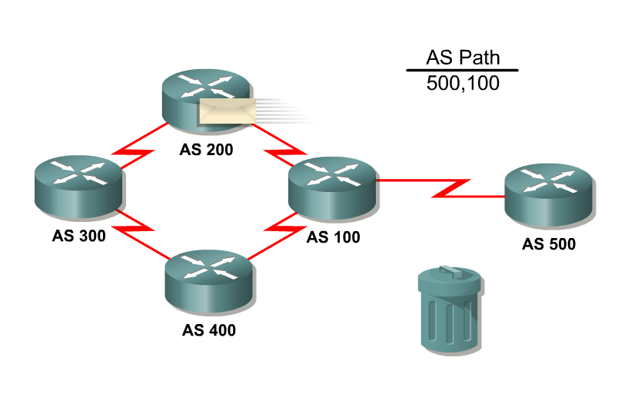
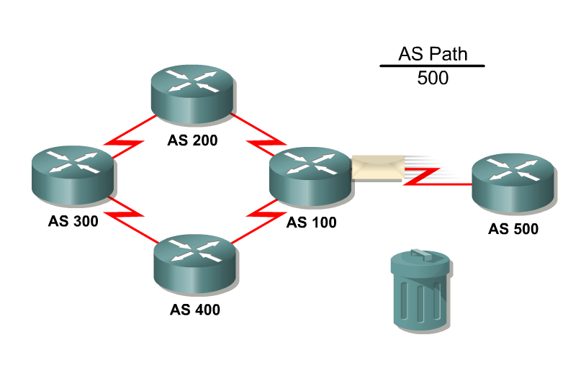
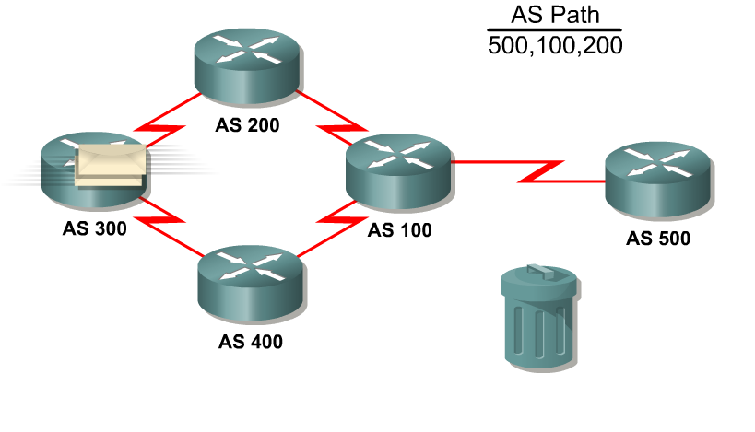
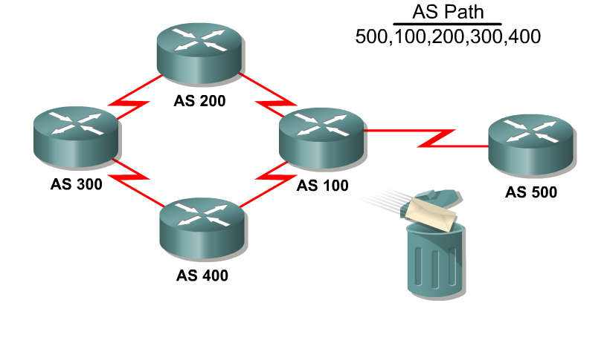
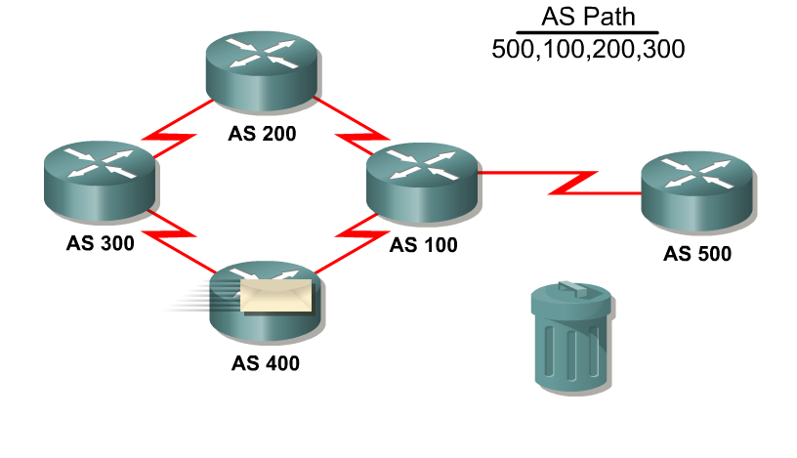
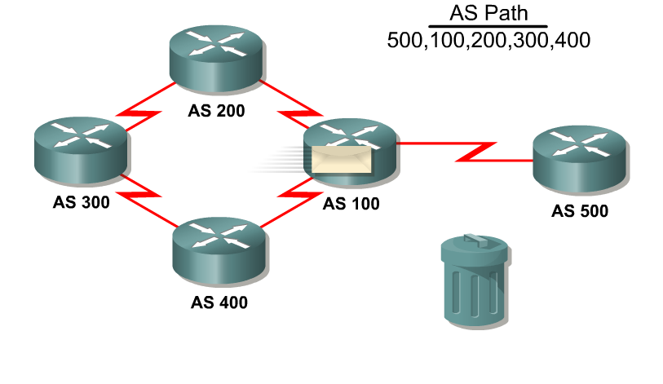
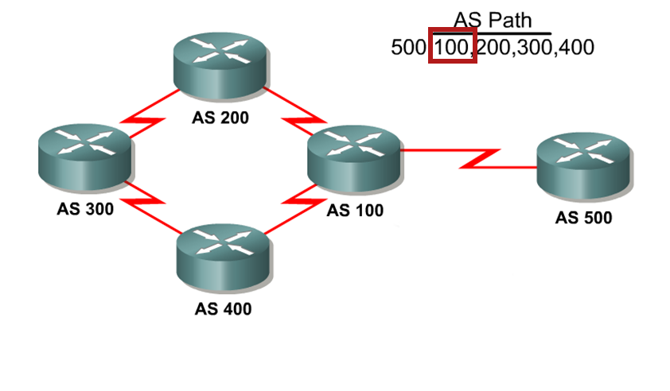
Well-Known Mandatory: AS_PATH
BGP always includes the AS_PATH attribute in its update.

Slide 53
Well-Known Mandatory: NEXT_HOP
The NEXT_HOP attribute indicates the IP address that is to be used to reach a destination.
The IP address is the entry point of the next AS along the path to that destination network.
Therefore, for EBGP, the next-hop address is the IP address of the neighbor that sent the update.

Slide 54
Well-Known Mandatory: ORIGIN
The ORIGIN attribute defines the origin of the path which could be:
IGP:
The route is interior to the originating AS and normally occurs when a network command is used to advertise the route via BGP.
An origin of IGP is indicated with an “i” in the BGP table.
EGP:
(Obsolete) The route is learned via EGP which is considered a historic routing protocol and is not supported on the Internet.
An origin of EGP is indicated with an “e” in the BGP table.
Incomplete:
The route’s origin is unknown or is learned via some other means and usually occurs when a route is redistributed into BGP.
An incomplete origin is indicated with a “?” in the BGP table.

Slide 55
Well-Known Mandatory: ORIGIN
i = Route generated by the network command.
R1# show ip bgp
BGP table version is 24, local router ID is 172.16.1.2
Status codes: s suppressed, d damped, h history, * valid, > best, i - internal
Origin codes: i - IGP, e - EGP, ? - incomplete
Network Next Hop Metric LocPrf Weight Path
*> 192.208.10.0 192.208.10.5 0 0 300 i
*> 172.16.1.0 0.0.0.0 0 32768 i
<output omitted>
R1# show ip bgp
<output omitted>
Network Next Hop Metric LocPrf Weight Path
*> 10.1.1.0/24 0.0.0.0 0 32768 ?
*> 192.168.1.0/24 10.1.1.2 84 32768 ?
*> 192.168.2.0/24 10.1.1.2 74 32768 ?
<output omitted>
? = Route generated by unknown method (usually redistributed).

Slide 56
Well-Known Discretionary: LOCAL_PREF
The Local Preference attribute provides an indication to the “local” routers in the AS about which path is preferred to exit the AS.
A path with a higher local preference is preferred.
The default value for local preference on a Cisco router is 100.
It is configured on a router and exchanged between IBGP routers.
It is not passed to EBGP peers.

Slide 57
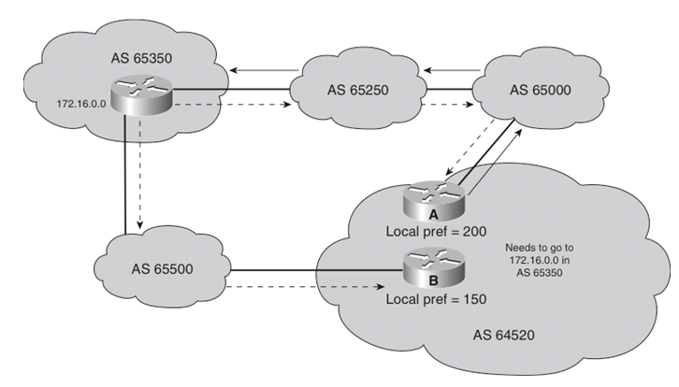
Well-Known Discretionary: LOCAL_PREF
Routers A and B are IBGP neighbors in AS 64520 and both receive updates about network 172.16.0.0 from different directions.
The local preference on router A is set to 200.
The local preference on router B is set to 150.
Because the local preference for router A is higher, it is selected as the preferred exit point from AS 64520.

Slide 58
Configuring the Default Local Preference
The bgp default local-preference command changes the default local preference value.
With this command, all IBGP routes that are advertised have the local preference set to the value specified.
If an EBGP neighbor receives a local preference value, the EBGP neighbor ignores it.

Slide 59
Well-Known Discretionary: ATOMIC_AGGREGATE
The Atomic Aggregate attribute is used to indicate that routes have been summarized.
Attribute warns that the received information may not necessarily be the most complete route information available.
Attribute is set to either True or False with “true” alerting other BGP routers that multiple destinations have been grouped into a single update.
Router update includes its router ID and AS number along with the supernet route enabling administrators to determine which BGP router is responsible for a particular instance of aggregation.
Tracing a supernet to its original "aggregator" may be necessary for troubleshooting purposes.

Slide 60
Optional Transitive: Community
The BGP community attribute can be used to filter incoming or outgoing routes.
BGP routers can tag routes with an indicator (the community) and allow other routers to make decisions based on that tag.
If a router does not understand the concept of communities, it defers to the next router.
However, if the router does understand the concept, it must be configured to propagate the community; otherwise, communities are dropped by default.
Communities are not restricted to one network or one AS, and they have no physical boundaries.

Slide 61
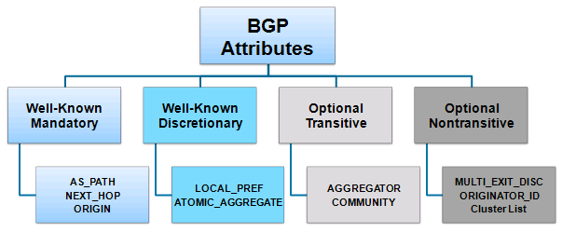
Optional Nontransitive
Attribute that may or may not be recognized by all BGP implementations.
Whether or not the receiving BGP router recognizes the attribute, it is nontransitive and is not passed along to other BGP peers.

Slide 62
Optional Nontransitive: MED
The Multiple Exit Discriminator (MED) attribute, also called the metric, provides a hint to external neighbors about the preferred path into an AS that has multiple entry points.
Lower MED is preferred over a higher MED!
The MED is sent to EBGP peers and those routers propagate the MED within their AS.
The routers within the AS use the MED, but do not pass it on to the next AS.
When the same update is passed on to another AS, the metric will be set back to the default of 0.
By using the MED attribute, BGP is the only protocol that can affect how routes are sent into an AS.
Notes:
Note:
MED influences inbound traffic to an AS.
Local preference influences outbound traffic from an AS.
Note:
By default, the MED comparison is done only if the neighboring AS is the same for all routes considered.
For the router to compare metrics from neighbors coming from different autonomous systems, the bgp always-compare-med router configuration command must be configured on the router.

Slide 63
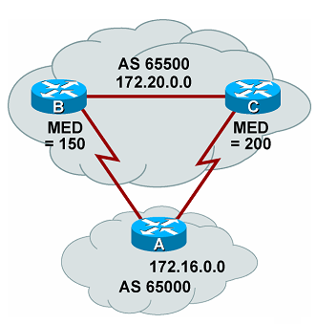
Optional Nontransitive: MED
Routers B and C include a MED attribute in the updates to router A.
Router B MED attribute is set to 150.
Router C MED attribute is set to 200.
When A receives updates from B and C, it picks router B as the best next hop because of the lower MED.

Slide 64
Cisco Weight Attribute
The Weight attribute is a Cisco proprietary attribute.
Similar in function to the local preference, the weight attribute applies when 1 router has multiple exit points.
Local preference is used when 2+ routers provide multiple exit points.
It is configured locally on a router and is not propagated to any other routers.
Routes with a higher weight are preferred when multiple routes exist to the same destination.
The weight can have a value from 0 to 65535.
Paths that the router originates have a weight of 32768 by default, and other paths have a weight of 0 by default.

Slide 65
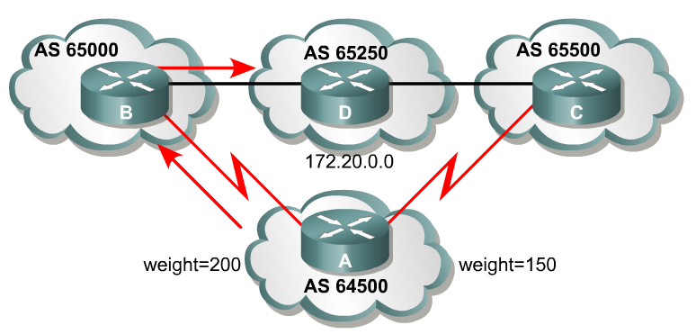
Cisco Weight Attribute
Routers B and C learn about network 172.20.0.0 from AS 65250 and propagate the update to router A.
Therefore Router A has two ways to reach 172.20.0.0.
Router A sets the weight of updates as follows:
Updates coming from router B are set to 200
Updates coming from router C are set to 150.
Router A uses router B because of the higher weight.

Slide 66
BGP Route Selection Process
The BGP best path decision is based on the value of attributes that the update contains and other BGP-configurable factors.
BGP considers only synchronized routes with no AS loops and a valid next-hop address.

Slide 67
BGP Route Selection Process
Prefer the route with highest weight.
Prefer the route with the lowest MED.
Prefer the EBGP route over IBGP route.
Prefer the route with highest LOCAL_PREF.
Prefer the route through the closest IGP neighbor.
Prefer the locally generated route (network or aggregate routes).
Prefer the oldest EBGP route.
Prefer the route with the shortest AS-PATH.
Prefer the route with the lowest neighbor BGP router ID value.
Prefer the route with the lowest ORIGIN (IGP<EGP<incomplete)
Prefer the route with the lowest neighbor IP address.
Notes:
The Highest Weight path is preferred. Weight is a Cisco proprietary parameter.
Prefer the route with the Highest Local Preference.
Prefer the route that was Locally Originated (originated by this router).
Prefer the route with the Shortest AS_path.
Prefer the route with the Lowest Origin Type. IGP < EGP < Incomplete.
Prefer the route with the Lowest MED.
Prefer the EBGP routes over IBGP.
If all the preceding scenarios are identical, prefer the route that can be reached via the closest IGP neighbor.
If the internal path is the same, the BGP router ID will be a tie breaker.
Prefer the route with the lowest router ID.
Router ID is the highest loopback address or highest IP address

Slide 68

Configuring BGP

Slide 69
Enable BGP Routing
Define BGP as the IP routing protocol.
Router(config)#
router bgp autonomous-system
The autonomous-system value is either an internally generated number (if not connecting to a provider network) or obtained from an ISP or RIR.
It is a required parameter.
It can be any positive integer in the range from 1 to 65535.
Only one instance of BGP can be configured on the router at a single time.
Notes:
The autonomous system number in this command is compared to the autonomous system numbers listed in neighbor statements to determine if the neighbor is an internal or external neighbor.
The syntax of basic BGP configuration commands is similar to the syntax for configuring internal routing protocols. However, there are significant differences in how BGP functions.
Use the router bgp autonomous-system command to identify to the router that any subsequent subcommands belong to this routing process. This command also identifies the local autonomous system in which this router belongs. The router needs to be informed of the autonomous system so it can determine if the BGP neighbors to be configured next are either Internal Border Gateway Protocol (IBGP) or External Border Gateway Protocol (EBGP) neighbors. The following table describes the router bgp command parameter:
The router bgp Command Parameter
The autonomous-system parameter identifies the local autonomous system number. The route bgp command alone cannot activate BGP on a router. You must enter at least one subcommand under the router bgp command to activate the BGP process on the router.
If you place your router in autonomous system “A” and then try to configure a new router bgp “B” command, the router informs you that you are currently configured for autonomous system A. You must insert the autonomous system number in the router bgp command so that the router can properly identify the relationship between the neighboring router and itself.

Slide 70
Defining BGP Neighbors
Identify peer router with which to establish a BGP session.
Router(config-router)#
neighbor {ip-address | peer-group-name} remote-as autonomous-system
The ip-address is the destination address of the BGP peer.
The address must be reachable before attempting to establish the BGP relationship.
The autonomous-system value is used to identify if the session is with internal BGP (IBGP) peers or with external BGP (EBGP) peers.
If the value is the same as the router’s AS, then an IBGP session is attempted.
If the value is not the same as the router’s AS, then an EBGP session is attempted.
Notes:
You use the neighbor ip-address remote-as autonomous-system command to activate a BGP session for external and internal neighboring routers.
This command identifies a peer router with which the local router will establish a session. The following table describes the neighbor remote-as command parameters:
Parameter Descriptions
ip-address Identifies the peer router.
peer-group-name Identifies the name of a BGP peer group.
autonomous-system Identifies the autonomous system of the peer router. A peer group is a group of BGP neighbors of the router being configured that all have the same update policies. Peer groups are described later in this lesson.
This command is mandatory for the establishment of each neighboring router relationship.
The address that is used in this command is the destination address for all BGP packets going to this neighboring router. In order for BGP to pass BGP routing information, this address must be reachable, because BGP attempts to establish a TCP session and exchange BGP updates with the device at this IP address.
The autonomous system number that is a part of this command is used to identify if this neighbor is an EBGP neighbor or an IBGP neighbor. If the autonomous system number is the same as the autonomous system number for this router, that neighbor is an IBGP neighbor and the IP address listed in this neighbor command does not have to be directly connected. If the autonomous system number is different from the autonomous system number for this router, this neighbor is an EBGP neighbor and the address in this neighbor command must be directly connected by default.

Slide 71
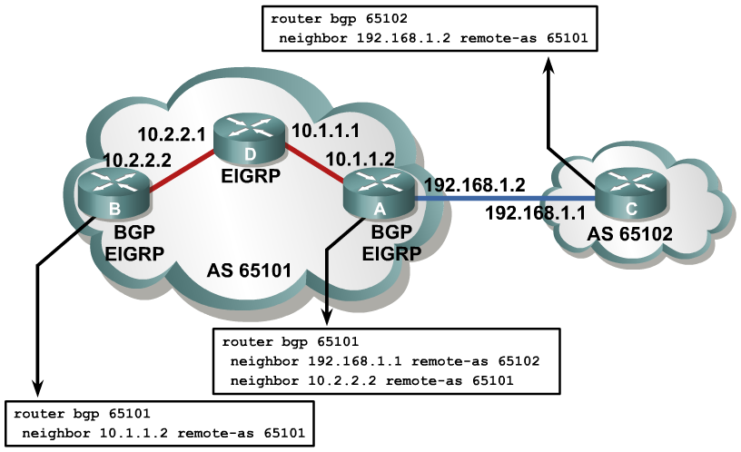
Example: BGP neighbor Command
Notes:
Example: BGP neighbor Command
In this figure, router A in AS 65101 has two neighbor statements. Router A knows that router C (neighbor 192.168.1.1 remote-as 65102) is an external neighbor because AS 65102 in the neighbor statement for router C does not match the autonomous system number of router A, which is AS 65101. Router A can reach AS 65102 via 192.168.1.1, which is directly connected to router A.
Neighbor 10.2.2.2 (router B) is in the same autonomous system as router A; the second neighbor statement on router A defines router B as an IBGP neighbor.
AS 65101 runs Enhanced Interior Gateway Routing Protocol (EIGRP) between all internal routers. Router A has an EIGRP path to reach IP address 10.2.2.2. As an IBGP neighbor, router B can be multiple routers away from router A.

Slide 72
IBGP Source IP Address Problem
BGP does not accept unsolicited updates.
It must be aware of every neighboring router and have a neighbor statement for it.
For example, when a router creates and forwards a packet, the IP address of the outbound interface is used as that packet’s source address by default.
For BGP packets, this source IP address must match the address in the corresponding neighbor statement on the other router or the routers will not establish the BGP session.
This is not a problem for EBGP neighbors as they are typically directly connected.

Slide 73
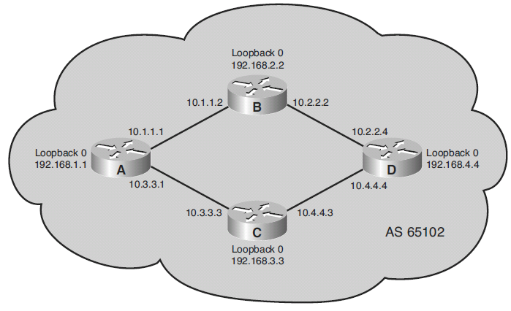
IBGP Source IP Address Problem
When multiple paths exist between IBGP neighbors, the BGP source address can cause problems:
Router D uses the neighbor 10.3.3.1 remote-as 65102 command to establish a relationship with A.
However, router A is sending BGP packets to D via B therefore the source IP address of the packets is 10.1.1.1.
The IBGP session between A and D cannot be established because D does not recognize 10.1.1.1 as a BGP neighbor.

Slide 74
IBGP Source IP Address Solution
Establish the IBGP session using a loopback interface.
Router(config-router)#
neighbor {ip-address | peer-group-name} update-source loopback interface-number
Informs the router to use a loopback interface address for all BGP packets.
Overrides the default source IP address for BGP packets.
Typically only used with IBGP sessions.
As an added bonus, physical interfaces can go down for any number of reasons but loopbacks never fail.
Notes:
The update-source option in the neighbor command overrides the default source IP address used for BGP packets. It is necessary to tell the router which IP address to use as the source address for all BGP packets if you want to use a loopback interface instead of the physical interface.
If you do not use the update-source option in the neighbor command, an announcement going to a neighbor uses the IP address of the exiting interface as the source address for a packet. When a router creates a packet, whether it is a routing update, a ping, or any other type of IP packet, the router does a lookup in the routing table for the destination address. The routing table lists the appropriate interface to get to the destination address. The address of this outbound interface is used as the source address of that packet by default.
Consider what would happen if a neighboring router uses the loopback interface address in its neighbor command for this router, but you do not use the neighbor update-source command on this router. When the neighboring router receives an update packet and looks at the source address of the packet, it sees that it has no neighbor relationship with that source address, so it discards the packet.
BGP does not accept unsolicited updates; it must be aware of every neighboring router and have a neighbor statement for it.

Slide 75
IBGP Source IP Address Example
AS 65101
AS 65102
AS 65100
10.1.1.0/24
172.16.1.1
.1
.2
192.168.1.1
R1
R2
EIGRP
R3
R4
.1
10.2.2.0/24
.2
Lo0 192.168.2.2
Lo0 192.168.3.3
R2(config)# router bgp 65101
R2(config-router)# neighbor 172.16.1.1 remote-as 65100
R2(config-router)# neighbor 192.168.3.3 remote-as 65101
R2(config-router)# neighbor 192.168.3.3 update-source loopback0
R2(config-router)# exit
R2(config)# router eigrp 1
R2(config-router)# network 10.0.0.0
R2(config-router)# network 192.168.2.0
R2(config-router)#
R3(config)# router bgp 65101
R3(config-router)# neighbor 192.168.1.1 remote-as 65102
R3(config-router)# neighbor 192.168.2.2 remote-as 65101
R3(config-router)# neighbor 192.168.2.2 update-source loopback0
R3(config-router)# exit
R3(config)# router eigrp 1
R3(config-router)# network 10.0.0.0
R3(config-router)# network 192.168.3.0
R3(config-router)#
Notes:
Notice as well that the IGP must now advertise the loopbacks as well.

Slide 76
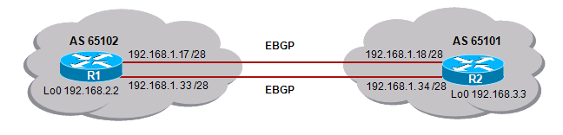
EBGP Dual-Homed Problem
R1 in AS 65102 is dual-homed with R2 in AS 65101.
A problem can occur if R1 only uses a single neighbor statement pointing to 192.168.1.18 on R2 .
If that link fails, the BGP session between these AS is lost, and no packets pass from one autonomous system to the next, even though another link exists.
A solution is configuring two neighbor statements on R1 pointing to 192.168.1.18 and 192.168.1.34.
However, this doubles the BGP updates from R1 to R2.

Slide 77
EBGP Dual-Homed Solution
The ideal solution is to:
Use loopback addresses.
Configure static routes to reach the loopback address of the other router.
Configure the neighbor ebgp-multihop command to inform the BGP process that this neighbor is more than one hop away.

Slide 78
Enable Multihop EBGP
Increase the time-to-live (TTL) for EBGP connections.
Router(config-router)#
neighbor {ip-address | peer-group-name} ebgp-multihop [ttl]
This command is of value when redundant paths exist between EBGP neighbors.
The default ttl is 1, therefore BGP peers must be directly connected.
The range is from 1 to 255 hops.
Increasing the ttl enables BGP to establish EBGP connections beyond one hop and also enables BGP to perform load balancing.
Notes:
When an EBGP router is peering with an external neighbor, the only address that it can reach without further configuration is the interface that is directly connected to that EBGP router. Because internal routing information is not exchanged with external peers, the router has to point to a directly connected address for that external neighbor.
A loopback interface is never directly connected. Therefore, if you want to use a loopback interface instead, use static routes pointing at the physical address of the directly connected network (the next-hop address). In addition to the static route, you need to use the neighbor ip-address ebgp-multihop [ttl] router configuration command.
This command allows the router to accept and attempt BGP connections to external peers residing on networks that are not directly connected. This command increases the default of one hop for EBGP peers by changing the default Time to Live (TTL) value of 1. It allows routes to the EBGP loopback address with a hop value greater than 1. By default, the TTL is set to 255 with this command. This command is of value when redundant paths exist between EBGP neighbors.

Slide 79
Multihop EBGP Example
AS 65102
EBGP
AS 65101
192.168.1.17 /28
192.168.1.18 /28
R1
R2
Lo0 172.17.1.1
192.168.1. 33 /28
EBGP
192.168.1. 34 /28
Lo0 172.16.1.1
R1(config)# router bgp 65102
R1(config-router)# neighbor 172.16.1.1 remote-as 65101
R1(config-router)# neighbor 172.16.1.1 update-source loopback0
R1(config-router)# neighbor 172.16.1.1 ebgp-multihop 2
R1(config-router)# exit
R1(config)# ip route 172.16.1.1 255.255.255.255 192.168.1.18
R1(config)# ip route 172.16.1.1 255.255.255.255 192.168.1.34
R1(config)#
R2(config)# router bgp 65101
R2(config-router)# neighbor 172.17.1.1 remote-as 65102
R2(config-router)# neighbor 172.17.1.1 update-source loopback0
R2(config-router)# neighbor 172.17.1.1 ebgp-multihop 2
R2(config-router)# exit
R2(config)# ip route 172.17.1.1 255.255.255.255 192.168.1.17
R2(config)# ip route 172.17.1.1 255.255.255.255 192.168.1.33
R2(config)#
Notes:
In these examples, the commands used on R1 and R2 inform BGP that the neighbor address is two hops away (one hop to the other router and one hop through the router to the loopback interface).
Note:
Recall that BGP is not designed to perform load balancing. Paths are chosen because of policy, not based on bandwidth. BGP will choose only a single best path.
Using the loopback addresses and the neighbor ebgp-multihop command allows load balancing, and redundancy, across the two paths between the AS.

Slide 80
Advertising EBGP Routes to IBGP Peers
When an EBGP router receives an update from an EBGP neighbor and forwards the update to its IBGP peers, the source IP address will still be that of the EBGP router.
IBGP neighbors will have to be configured to reach that external IP address.
Another solution is to override a router’s default behavior and force it to advertise itself as the next-hop address for routes sent to a neighbor.
To do so, use the neighbor next-hop-self router configuration command

Slide 81
neighbor next-hop-self Command
Configure the router as the next hop for a BGP-speaking peer.
Router(config-router)#
neighbor {ip-address | peer-group-name} next-hop-self
The command forces BGP to advertise itself as the source of the routes.
The ip-address identifies the peer router to which advertisements will be sent, with this router identified as the next hop.
This command is useful in unmeshed networks (such as Frame Relay) where BGP neighbors may not have direct access to all other neighbors on the same IP subnet.

Slide 82
Next Hop Self Example
AS 65101
AS 65102
AS 65100
10.1.1.0/24
172.16.1.1
.1
.2
192.168.1.1
R1
R2
EIGRP
R3
R4
.1
10.2.2.0/24
.2
Lo0 192.168.2.2
Lo0 192.168.3.3
R2(config)# router bgp 65101
R2(config-router)# neighbor 172.16.1.1 remote-as 65100
R2(config-router)# neighbor 192.168.3.3 remote-as 65101
R2(config-router)# neighbor 192.168.3.3 update-source loopback0
R2(config-router)# neighbor 192.168.3.3 next-hop-self
R2(config-router)# exit
R2(config)# router eigrp 1
R2(config-router)# network 10.0.0.0
R2(config-router)# network 192.168.2.0
R2(config-router)#
Notes:
R2 uses the neighbor next-hop-self command to change the default BGP next-hop settings.
After this command is configured, R2 advertises a next hop of 192.168.2.2 (the IP address of its loopback interface) to its IBGP neighbor because that is the source IP address of the routing update to its IBGP neighbor (set with the neighbor update-source command).

Slide 83
BGP Synchronization
Recall that the BGP synchronization rule states that:
“A BGP router should not use, or advertise a route learned by IBGP, unless that route is local or is learned from the IGP.”
By default synchronization is disabled, therefore BGP can use and advertise to an external BGP neighbor routes learned from an IBGP neighbor that are not present in the local routing table.
Use the synchronization router configuration command to enable BGP synchronization so that a router will not advertise routes in BGP until it learns them in an IGP.
The no synchronization router configuration command disables synchronization.
Notes:
BGP synchronization is disabled by default in Cisco IOS Software Release 12.2(8)T and later; it was on by default in earlier Cisco IOS Software releases.

Slide 84
Defining Networks That BGP Advertises
Two options are available to advertise networks into BGP:
The network command.
Redistributing IGP routes into BGP.
Note: Redistributing is not recommended because it could result in unstable BGP tables.
Notes:
Using a redistribute command into BGP results in an incomplete origin attribute for the route, as indicated by the ? in the show ip bgp command output.

Slide 85
Identify BGP Networks
Enable BGP to advertise a network if it is present.
Router(config-router)#
network network-number [mask network-mask] [route-map map-tag]
The BGP network command determines which networks this router advertises.
Unlike IGPs, the command does not start BGP on specific interfaces.
The mask parameter indicates that BGP-4 supports subnetting and supernetting.
If the mask is not specified, this command announces only the classful network
It is also important to note that the prefix must exactly match (address and mask) an entry in the IP routing table.

Slide 86
BGP Route Must Be in IP Routing Table
It is important to understand that any network (both address and mask) must exist in the routing table for the network to be advertised in BGP.
For example, to summarize many networks and advertise a CIDR block 192.168.0.0/16, configure:
network 192.168.0.0 mask 255.255.0.0
ip route 192.168.0.0 255.255.0.0 null0
Now BGP can find an exact match in the routing table and announce the 192.168.0.0/16 network to its neighbors.
The advertised static route would never actually be used since BGP would contain longer prefix matching routes in its routing table.

Slide 87
Clearing the BGP Session
When policies such as access lists or attributes are changed, the Cisco IOS applies changes on only those updates received or sent after and not existing routes in the BGP and routing tables.
It can take a long time for the policy to be applied to all networks.
There are three ways to ensure that the policy change is immediately applied to all affected prefixes and paths.
Hard reset
Soft reset (outbound and inbound)
Route refresh
Notes:
BGP can potentially handle huge volumes of routing information. When a policy configuration change occurs, the router cannot go through the huge table of BGP information and recalculate which entry is no longer valid in the local table. Nor can the router determine which route or routes, already advertised, should be withdrawn from a neighbor. There is an obvious risk that the first configuration change will be immediately followed by a second, which would cause the whole process to start all over again. To avoid such a problem, Cisco IOS software applies changes only to those updates that are received or transmitted after the BGP policy configuration change has been performed. The new policy, enforced by the new filters, is applied only on routes that are received or sent after the change.
A network administrator who would like the policy change to be applied on all routes must trigger an update to force the router to let all routes pass through the new filter. If the filter is applied on outgoing information, the router has to resend the BGP table through the new filter. If the filter is applied on incoming information, the router needs its neighbor to resend its BGP table so that it passes through the new filters.
There are three ways to trigger an update: with a hard reset, soft reset, and route refresh.

Slide 88
Hard Reset of BGP Sessions
Reset all BGP connections with this router.
Router#
clear ip bgp {* | neighbor-address}
Entire BGP forwarding table is discarded.
BGP session makes the transition from established to idle; everything must be relearned.
When the neighbor-address value is used, it resets only a single neighbor and BGP session. Everything from this neighbor must be relearned.
It is less severe than clear ip bgp *.
Notes:
Resetting a session is a method of informing the neighbor or neighbors of a policy change. If BGP sessions are reset, all information received on those sessions is invalidated and removed from the BGP table. Also, the remote neighbor will detect a BGP session down state, and likewise will invalidate the routes that were received. After a period of 30 to 60 seconds, the BGP sessions are re-established automatically and the BGP table is exchanged again, but through the new filters. However, resetting the BGP session disrupts packet forwarding.
The two commands shown in the figure both cause a hard reset of the BGP neighbors that are involved. A “hard reset” means that the router issuing either of these commands will close the appropriate TCP connections, re-establish those TCP sessions as appropriate, and resend all information to each of the neighbors affected by the particular command that is used.
By using clear ip bgp *, the BGP forwarding table on the router that issued this command is completely deleted and all networks must be relearned from every neighbor. If a router has multiple neighbors, this action is a very dramatic event. This command forces all neighbors to resend their entire tables simultaneously.
For example, consider a situation in which router A has eight neighbors and each neighbor has a full Internet table of about 32 MB in size. If router A issues the clear ip bgp * command, all eight routers will resend their 32-MB table at the same time. To hold all these updates, router A would need 256 MB of RAM. Router A would also need to be able to process all of this information. Processing 256 MB of updates would take a considerable amount of CPU cycles for router A, further delaying the routing of user data.
If the second command, clear ip bgp [neighbor-address], is used instead, one neighbor is reset at a time. The impact is less severe on the router that is issuing this command; however, it takes longer to change policy for all of the neighbors, because each must be done individually as opposed to all at once using the clear ip bgp * command. The clear ip bgp [neighbor-address] command still performs a hard reset and must re-establish the TCP session with the specified address that is used in the command, but this command affects only a single neighbor at a time and not all neighbors at once.

Slide 89
Monitoring Received BGP Routes
Command | Description
show ip bgp neighbors {address} received-routes | Displays all received routes (both accepted and rejected) from the specified neighbor.
show ip bgp neighbors {address} routes | Displays all routes that are received and accepted from the specified neighbor. This output is a subset of the output displayed by the received-routes keyword.
show ip bgp | Displays entries in the BGP table.
show ip bgp neighbors {address} advertised-routes | Displays all BGP routes that have been advertised to neighbors.

Slide 90
BGP Configuration Example #1
AS 64520
AS 65000
172.16.0.0
.1
10.1.1.0
.2
172.17.0.0
R1
R2
R1(config)# router bgp 64520
R1(config-router)# neighbor 10.1.1.2 remote-as 65000
R1(config-router)# network 172.16.0.0
R1(config-router)#
R2(config)# router bgp 65000
R2(config-router)# neighbor 10.1.1.1 remote-as 64520
R2(config-router)# network 172.17.0.0
R2(config-router)#

Slide 91
BGP Configuration Example #2
AS 65010
AS 65020
10.2.2.0 /24
10.1.1.0 /24
.1
.2
.1
.2
10.3.3.0 /24
R1
R2
R3
Lo0 10.4.4.4
Lo0 10.5.5.5
R2(config)# router bgp 65010
R2(config-router)# neighbor 10.1.1.2 remote-as 65020
R2(config-router)# network 10.2.2.0 mask 255.255.255.0
R2(config-router)# network 10.4.4.0 mask 255.255.255.0
R2(config-router)#

Slide 92
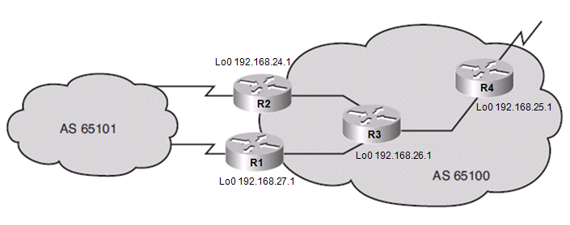
BGP With Peer Group Example
R1(config)# router bgp 65100
R1(config-router)# neighbor INTERNAL peer-group
R1(config-router)# neighbor INTERNAL remote-as 65100
R1(config-router)# neighbor INTERNAL update-source loopback 0
R1(config-router)# neighbor INTERNAL next-hop-self
R1(config-router)# neighbor INTERNAL distribute-list 20 out
R1(config-router)# neighbor 192.168.24.1 peer-group INTERNAL
R1(config-router)# neighbor 192.168.25.1 peer-group INTERNAL
R1(config-router)# neighbor 192.168.26.1 peer-group INTERNAL
R1(config-router)#
Notes:
Adding a new neighbor with the same policies as the other IBGP neighbors to R1 when it is using a peer group requires adding only a single neighbor statement to link the new neighbor to the peer group.
Without peer groups, adding that same neighbor to R1 would require 4 neighbor statements.
Using a peer group also makes the configuration easier to read and change.
If you need to add a new policy, such as a route map, to all IBGP neighbors on R1, and you are using a peer group, you need only to link the route map to the peer group.
Without a peer group, R1 needs to add the new policy to each neighbor.

Slide 93
IBGP and EBGP Example
AS 64520
AS 65000
172.16.30.0
172.16.20.0
.1
10.1.1.0 /24
.2
192.168.1.0 /24
.3
R1
.2
R2
.2
192.168.4.0 /24
.3
R3
172.16.10.0
Lo0 192.168.2.2 /32
Lo0 192.168.3.3 /32
R2(config)# router bgp 65000
R2(config-router)# neighbor 10.1.1.1 remote-as 64520
R2(config-router)# neighbor 192.168.3.3 remote-as 65000
R2(config-router)# neighbor 192.168.3.3 update-source loopback 0
R2(config-router)# neighbor 192.168.3.3 next-hop-self
R2(config-router)# network 172.16.20.0 mask 255.255.255.0
R2(config-router)# network 192.168.1.0
R2(config-router)# network 192.168.3.0
R2(config-router)# no synchronization
R2(config-router)#

Slide 94

Verifying and Troubleshooting BGP

Slide 95
Verifying and Troubleshooting BGP
Command | Description
show ip bgp | Displays entries in the BGP table. Specify a network number to get more specific information about a particular network.
show ip bgp neighbors | Displays detailed information about the TCP and BGP connections to neighbors.
show ip bgp summary | Displays the status of all BGP connections.
show ip bgp neighbors {address} advertised-routes | Displays all BGP routes that have been advertised to neighbors.
show ip bgp rib-failure | Displays BGP routes that were not installed in the routing information base (RIB), and the reason that they were not installed.
debug ip bgp [dampening | events | keepalives | updates]

Slide 96
Verifying BGP: show ip bgp
Display the BGP topology database (the BGP table).
The status codes are shown in the first column of each line of output.
* means that the next-hop address (in the fifth column) is valid.
r means a RIB failure and the route was not installed in the RIB.
R1# show ip bgp
BGP table version is 14, local router ID is 172.31.11.1
Status codes: s suppressed, d damped, h history, * valid, > best, i - internal, r RIB-failure, S Stale
Origin codes: i - IGP, e - EGP, ? - incomplete
Network Next Hop Metric LocPrf Weight Path
*> 10.1.0.0/24 0.0.0.0 0 32768 i
* i 10.1.0.2 0 100 0 i
*> 10.1.1.0/24 0.0.0.0 0 32768 i
*>i10.1.2.0/24 10.1.0.2 0 100 0 i
*> 10.97.97.0/24 172.31.1.3 0 64998 64997 i
* 172.31.11.4 0 64999 64997 i
* i 172.31.11.4 0 100 0 64999 64997 i
*> 10.254.0.0/24 172.31.1.3 0 0 64998 i
* 172.31.11.4 0 64999 64998 i
* i 172.31.1.3 0 100 0 64998 i
r> 172.31.1.0/24 172.31.1.3 0 0 64998 i
r 172.31.11.4 0 64999 64998 i
r i 172.31.1.3 0 100 0 64998 i
*> 172.31.2.0/24 172.31.1.3 0 0 64998 i
A > in the second column indicates the best path for a route selected by BGP.
This route is offered to the IP routing table.
The third column is either blank or has an “i” in it.
- If it has an i, an IBGP neighbor advertised this route to this router.
- If it is blank, BGP learned that route from an external peer.
This section lists three BGP path attributes: metric (MED), local preference, and weight.
The Path section lists the AS path. The last AS # is the originating AS.
If blank the route is from the current autonomous system.
The last column displays the ORIGIN attribute).
- i means the original router probably used a network command to introduce this network into BGP.
- ? means the route was probably redistributed from an IGP into the BGP process.
Notes:
Other first column options:
An s indicates that the specified routes are suppressed (usually because routes have been summarized and only the summarized route is being sent).
A d, for dampening, indicates that the route is being dampened (penalized) for going up and down too often. Although the route might be up right now, it is not advertised until the penalty has expired.
An h, for history, indicates that the route is unavailable and is probably down. Historic information about the route exists, but a best route does not exist.
An r, for RIB failure, indicates that the route was not installed in the RIB. The reason that the route is not installed can be displayed using the show ip bgp rib-failure command.
An S, for stale, indicates that the route is stale. (This is used in a nonstop forwarding aware router.)

Slide 97
Verifying BGP: show ip bgp summary
Verify the BGP neighbor relationship.
R1# show ip bgp summary
BGP router identifier 10.1.1.1, local AS number 65001
BGP table version is 124, main routing table version 124
9 network entries using 1053 bytes of memory
22 path entries using 1144 bytes of memory
12/5 BGP path/bestpath attribute entries using 1488 bytes of memory
6 BGP AS-PATH entries using 144 bytes of memory
0 BGP route-map cache entries using 0 bytes of memory
0 BGP filter-list cache entries using 0 bytes of memory
BGP using 3829 total bytes of memory
BGP activity 58/49 prefixes, 72/50 paths, scan interval 60 secs
Neighbor V AS MsgRcvd MsgSent TblVer InQ OutQ Up/Down State/PfxRcd
10.1.0.2 4 65001 11 11 124 0 0 00:02:28 8
172.31.1.3 4 64998 21 18 124 0 0 00:01:13 6
172.31.11.4 4 64999 11 10 124 0 0 00:01:11 6
Notes:
Here are some of the highlights:
BGP router identifier—IP address that all other BGP speakers recognize as representing this router.
BGP table version—Increases in increments when the BGP table changes.
Main Routing table version—Last version of BGP database that was injected into the main routing table.
Neighbor—The IP address, used in the neighbor statement, with which this router is setting up a relationship.
Version (V)—The version of BGP this router is running with the listed neighbor.
AS—The listed neighbor’s AS number.
Messages received (MsgRcvd)—The number of BGP messages received from this neighbor.
Messages sent (MsgSent)—The number of BGP messages sent to this neighbor.
TblVer—The last version of the BGP table that was sent to this neighbor.
In queue (InQ)—The number of messages from this neighbor that are waiting to be processed.
Out queue (OutQ)—The number of messages queued and waiting to be sent to this neighbor. TCP flow control prevents this router from overwhelming a neighbor with a large update.
Up/Down—The length of time this neighbor has been in the current BGP state (established, active, or idle).
State—The current state of the BGP session—active, idle, open sent, open confirm, or idle (admin). The admin state is new to Cisco IOS Software Release 12.0; it indicates that the neighbor is administratively shut down. This state is created by using the neighbor ip-address shutdown router configuration command. (Neighbor states are discussed in more detail in the “Understanding and Troubleshooting BGP Neighbor States” section later in this chapter.) Note that if the session is in the established state, a state is not displayed; instead, a number representing the PfxRcd is displayed, as described next.

Slide 98
Resources
BGP Case Studies
http://www.cisco.com/en/US/customer/tech/tk365/technologies_tech_note09186a00800c95bb.shtml
Using Regular Expressions
http://www.cisco.com/en/US/customer/tech/tk365/technologies_tech_note091
http://www.cisco.com/en/US/customer/products/hw/switches/ps718/products_command_reference_chapter09186a008009166c.html 86a0080094a92.shtml

Slide 99


